Slide 1
Simple GUI calculator using Tkinter
Project 1

Slide 2
Introduction
This project will show you how to use Python Tkinter to make a straightforward calculator application. To do this, we'll employ a variety of GUI design components, including tkinter buttons, tkinter labels, tkinter entries, tkinter frames, tkinter check buttons, etc.
Here is how our calculator would seem; it is produced using an input field, buttons, and logic in our code specified in functions. For example, for adding two numbers, there must be logic encapsulated in the add() function; similarly, for subtraction, multiplication, etc., we have established functions whose job it is to carry out these operations.

Slide 3
Elements of a simple Calculator
We have an input area where the user's input and the results of the computation will both be shown. The buttons also include the following additional keys: the digits 0 to 9, +, -, *, /, =, and C. (clear button)
Any GUI application is typically designed using two processes:
The first step is creating a user interface.
The second step, which includes adding new functionality to the GUI, is the most important one.

Slide 4
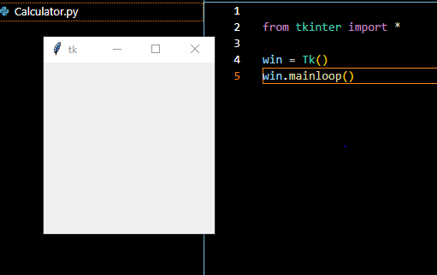
Step 1
The first step is creating a user interface.
Install a GUI library on our system.
from tkinter import*
Create variable ‘win’ to store Tk() library.
win=Tk()
Win.mainloop()

Slide 5
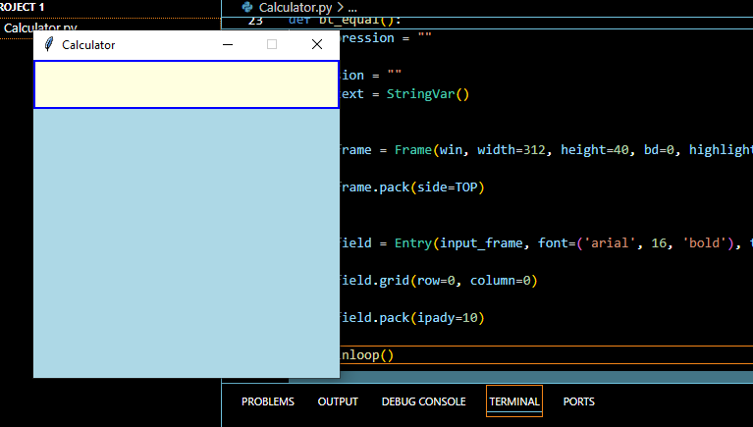
Step 2
input_text = StringVar()
A variable defined using StringVar() holds a string data where we can set text value and can retrieve it.
Create a frame for input field and inside we create input field to show expressions.

Slide 6
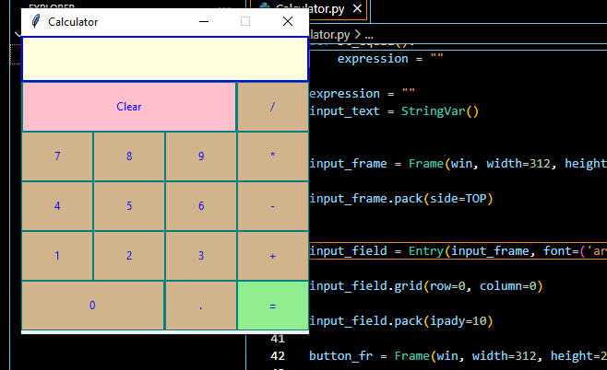
Step 3
In this step, which includes adding new functionality to the GUI, is the most important one.
We create the button like: the digits 0 to 9, +, -, *, /, =, and C. (clear button)
We use the command lambda on button click.
command = lambda: btn_click()

Slide 7
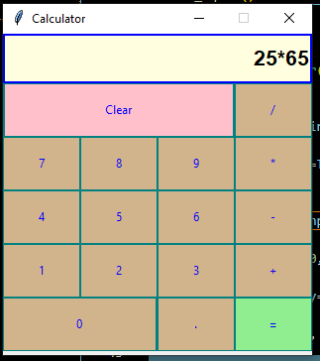
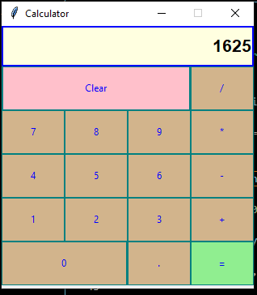
Calculator is ready

Slide 8
Conclusion
In conclusion, the Simple GUI Calculator project using Tkinter demonstrates the effective integration of Python programming and graphical user interface design. Through this project, we explored the fundamentals of Tkinter to create a functional and user-friendly calculator. The project covered essential aspects such as layout management, widget utilization, and event handling, providing a solid foundation for further GUI development in Python. This project not only highlights the versatility of Tkinter but also serves as a practical application of basic programming principles, making it an excellent learning experience for beginners in software development.

